Slide 1
Salon Advisory Membership tax law update
Presented by
Chris Wittich, MBT, CPA

Slide 2
Disclaimers
The information contained herein should not be construed as legal, accounting, or tax advice. The commentaries provided are the opinions of Boyum Barenscheer PLLP and are for informational purposes only. While the information is deemed reliable, Boyum Barenscheer cannot guarantee its accuracy, completeness, or suitability for any purpose and makes no warranties with regard to the results to be obtained from its use, or whether any expressed course of events will actually occur. The user should contact his or her Boyum Barenscheer or other tax professional prior to taking any action to ensure the user's unique facts and circumstances are considered prior to making any decisions.

Slide 3
Agenda
Inflation Reduction Act August 2022
Omnibus Spending Bill December 2022
1099-K reporting December 2022
3 Key Things for 2023

Slide 4
Inflation Reduction Act
Passed August 2022
Energy Efficient Home Improvement Credit
Now up to $1,200 per year every year instead of a lifetime limit, limit of $600 per item
Windows, Furnace, Doors, Home Energy Audits, Water Heaters, Insulation, A/C
Residential Energy Efficient Property Credit
30% for things like solar, electric, wind, alternate energy on a home
Funding for IRS over a 10 year period to hopefully provide better service, long term money allocated do not expect to see immediate results on that investment

Slide 5
Inflation Reduction Act
Clean Vehicle Credits of $7,500 that are nearly impossible to claim for plug in electric vehicles
Final assembly must occur in North America
Vehicles must have purchase price of less than $80k for SUV/Van or $55k for other vehicles
AGI Income cap on the individual of $300k for joint, $150k for single
For used vehicles sale price cannot exceed $25k
For used vehicles AGI limit of $150k / $75k and credit limit of $4k

Slide 6
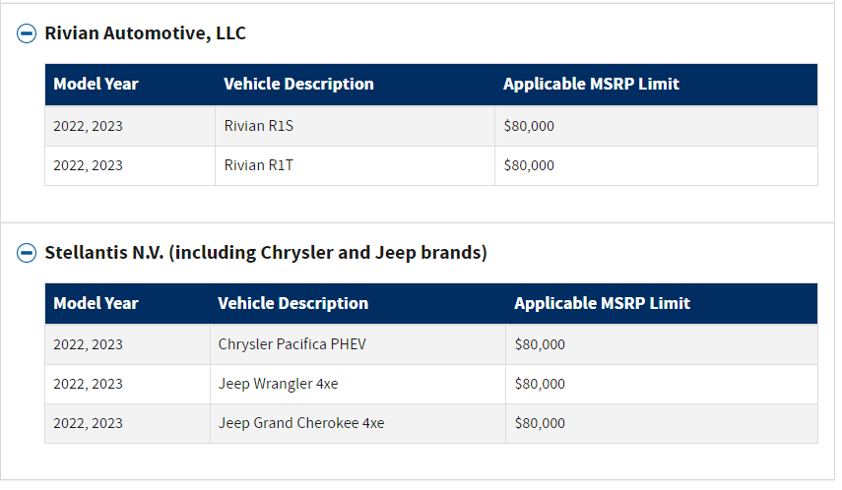
Inflation Reduction Act

Slide 7
Omnibus Spending Bill
$1.7T spending bill which had the potential to include lots of tax rules, but in the end did not include any
NOT in the Bill
Tax Extenders
100% Bonus depreciation extension
Expanded child tax credits, expanded daycare credits, expanded EITC
Section 174 fix for research and development costs
Interest Expense limitations in Section 163j
Tip Credit for salons did not make it into the bill
Secure Act 2.0 items did make it into the bill, more on that next

Slide 8
Omnibus Spending Bill
Secure Act 2.0 was included in the bill
RMD increase from 72 to 73, going up to 75 by 2033
Most new 401k plans need to auto enroll participants starting in 2025
Changes to allow more Roth employer contributions which would be taxed
Increases to SIMPLE IRA contribution limits and catchup, changes to SIMPLE IRA rules and required employer contributions for SIMPLE plans
2023 contributions $15,500 (+$3,500 over 50 years old)

Slide 9
Omnibus Spending Bill
Secure Act 2.0 was included in the bill
Increased catchup contributions to 401k plans for those over 50 starting in 2023 and a new super catchup for those over 60 starting in 2025
2023 limit $22,500 for 401k plans (+$7,500 over 50 years old)
2025 limits unknown, but +$10,000 over 60 years old more than normal catchup
2023 limit $6,500 for IRA / Roth IRA (+$1,000 over 50 years old)
Increased the Qualified Charitable Distributions for inflation
New and expanded penalty waivers for early distributions
Incredible complexity and nuance to the changes will require regulation and time to digest and understand everything in the bill

Slide 10
Omnibus Spending Bill
Secure Act 2.0 was included in the bill
Higher individual contribution limits
More Roth options
More complexity with retirement plan offerings
More complexity with accessing retirement money early
Shifting more responsibility and opportunity to the individual taxpayer to fund retirements

Slide 11
1099-K Reporting
IRS delayed the 1099-K reporting standards.
1099-K expanded to include apps like paypal, cashapp, venmo who were going to need to report any transfers over $600. Delayed to 2023 by the IRS notice in Dec 2022, so $20,000 threshold applies in 2022.
Reminder that salons are required to ask all employees to report their tips (cash, venmo, paypal, cashapp, etc). The tips need to be reported through payroll. We are in the process of creating a resource you can provide to employees which will explain any 1099-K that they receive.

Slide 12
3 Key Things for 2023
Bonus Depreciation is scheduled to be 80% in 2023, but Section 179 is still available to potentially achieve 100% depreciation on new assets the business acquires
Keep in mind energy efficient tax credits for personal residence, keep receipts and think of energy efficient qualifications when doing home improvement projects
Be aware of retirement plan changes through the Secure Act 2.0, summer 2023 is the time to reevaluate your personal retirement plan contribution strategy and consider plan offerings for employees in the future

Slide 13
Questions & Answers
Chris Wittich, MBT, CPA cwittich@myboyum.com
Salon Team Lead, ERC Team Lead
Becky Casalenda, CPA
bcasalenda@myboyum.com
Salon Team Service Provider
Tracy Stevens, CPA
tstevens@myboyum.com
Salon Team Service Provider

