Slide 1



Beneficial Owner Information Reporting
Presented by
Chris Wittich, MBT, CPA

Slide 2
Disclaimers
The information contained herein should not be construed as legal, accounting, or tax advice. The commentaries provided are the opinions of Boyum Barenscheer PLLP and are for informational purposes only. While the information is deemed reliable, Boyum Barenscheer cannot guarantee its accuracy, completeness, or suitability for any purpose and makes no warranties with regard to the results to be obtained from its use, or whether any expressed course of events will actually occur. The user should contact his or her Boyum Barenscheer or other tax professional prior to taking any action to ensure the user's unique facts and circumstances are considered prior to making any decisions.

Slide 3
Agenda
Corporate Transparency Act
Who is required to file?
When is it required to be filed?
What information is required on the report?
What are the penalties?
How do you file BOI?
Examples + Closing thoughts + Q&A

Slide 4
Corporate Transparency Act
Congress passed the Corporate Transparency Act in 2021 as part of Bank Secrecy Act
  Mandates that millions of entities report their beneficial ownership information to the Financial Crimes Enforcement Network (FinCEN)
  FinCEN would use that information to improve transparency and tracking and enhance enforcement efforts for financial crimes
  FinCEN estimates 32.6 million existing reporting companies
  FinCEN estimates 5 million new reporting companies each year
  2024 is the first year for the BOI reporting

Slide 5
Who is required to file?
All domestic and foreign entities that have filed formation or registration documents with a US State unless they meet an exception listed below
23 industry exceptions
Exempt – large operating entities
Exempt – publicly traded companies

Slide 6
Who is required to file?
23 industry exceptions
  Securities reporting issuer
  Governmental authority
  Bank
  Credit Union
  Depository institution holding company
  Money services business
  Broker or dealer in securities
  Securities exchange or clearing agency
  Other exact act registered entity
  Investment company or investment adviser
  Venture capital fund adviser
  Insurance company
  State licensed insurance producer
  Commodity exchange Act registered entity
  Accounting firm
  Public utility
  Financial market utility
  Pooled investment vehicle
  Tax exempt entity
  Entity assisting a tax exempt entity
  Large operating company
  Subsidiary of certain exempt entities
  Inactive entity

Slide 7
Who is required to file?
Exempt – large operating entities that meet all 3 of these:
  Employ more than 20 FTE in the US. This is the same definition as full time employee that was used for ERC purposes and for health insurance purposes. It requires an average of 30 hours per week to be considered full time employee.
  Gross receipts or sales over $5M on the prior year’s tax return. This only includes US based gross receipts or sales.
  Has a physical office in the US. Entity regularly conducts business at physical location either owned or leased and is not shared with any other entity.

Slide 8
When is it required to be filed?
Entities formed prior to 1-1-2024 have until 12-31-2024 to make their initial filing
Entities formed during 2024 have 90 days to complete their initial filing from the date of their initial formation
For 2025 the report will be required to be updated within 30 days of a change in the information
  Change of address for a beneficial owner
  New beneficial owner joins the company
  Restructuring changes the beneficial owner

Slide 9
What information is required to be on the report?
Beneficial Owner is any individual who:
Directly or indirectly exercises substantial control over the company
OR
Owns/controls at least 25% of the ownership interests
Business can have multiple beneficial owners in each category. Could have multiple officers who exercise substantial control. Could have multiple people that own at least 25% of the ownership interest.

Slide 10
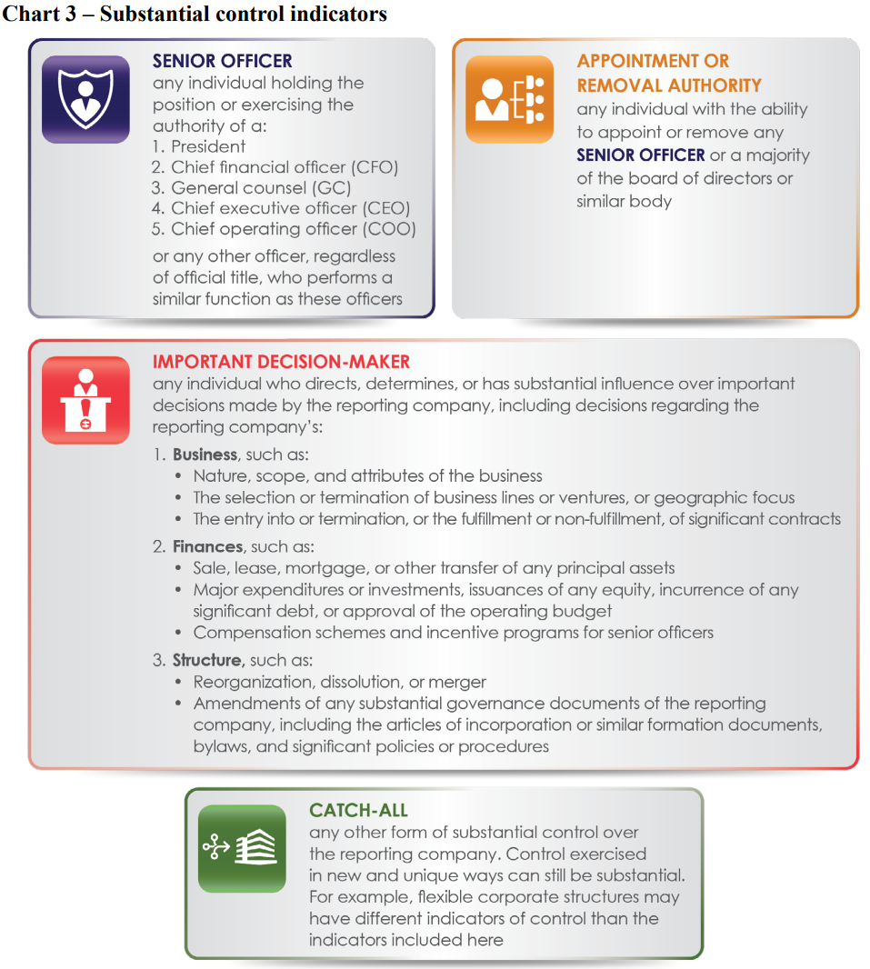
What information is required to be on the report?

Slide 11
What information is required to be on the report?
Business reporting:
Full legal name of the reporting company and any trade or DBA names
Address of principal place of business
State of formation
IRS EIN

Slide 12
What information is required to be on the report?
Individual reporting:
Full legal name
Birthdate
Current Address
Unique identifying number and issuing jurisdiction and image of the document (US passport, State drivers license, identification document issued by state)
Alternatively a FinCEN identifier for the individual

Slide 13
What are the penalties?
Civil penalties of $500 per day for a willful violation
Criminal penalties of $10,000 and/or two years imprisonment
What is a willful violation? Hard to say because it’s not defined, but the penalties exist so FinCEN can hit people really hard if they are doing bad things. Similar to the FBAR penalties which start at $10k.

Slide 14
How do you file BOI?
Online filing at FinCEN website is currently the only method
File PDF BOI Report – basically fill out a PDF offline and then upload it
File online BOI Report – basically work through everything online in a live format and then submit it electronically
System to System API – income tax software providers might be able to submit these down the road

Slide 15
How do you file BOI?
Individual FinCEN identifier can be used by individuals to setup their own account with FinCEN and keep their own information up to date
  Rather than a business having to update when each individual person moves the individual would be keeping their own information up to date. It’s less work for the business, but requires the individual to setup an account and make changes. It can be beneficial especially when there are more than one beneficial owners being reported.

Slide 16
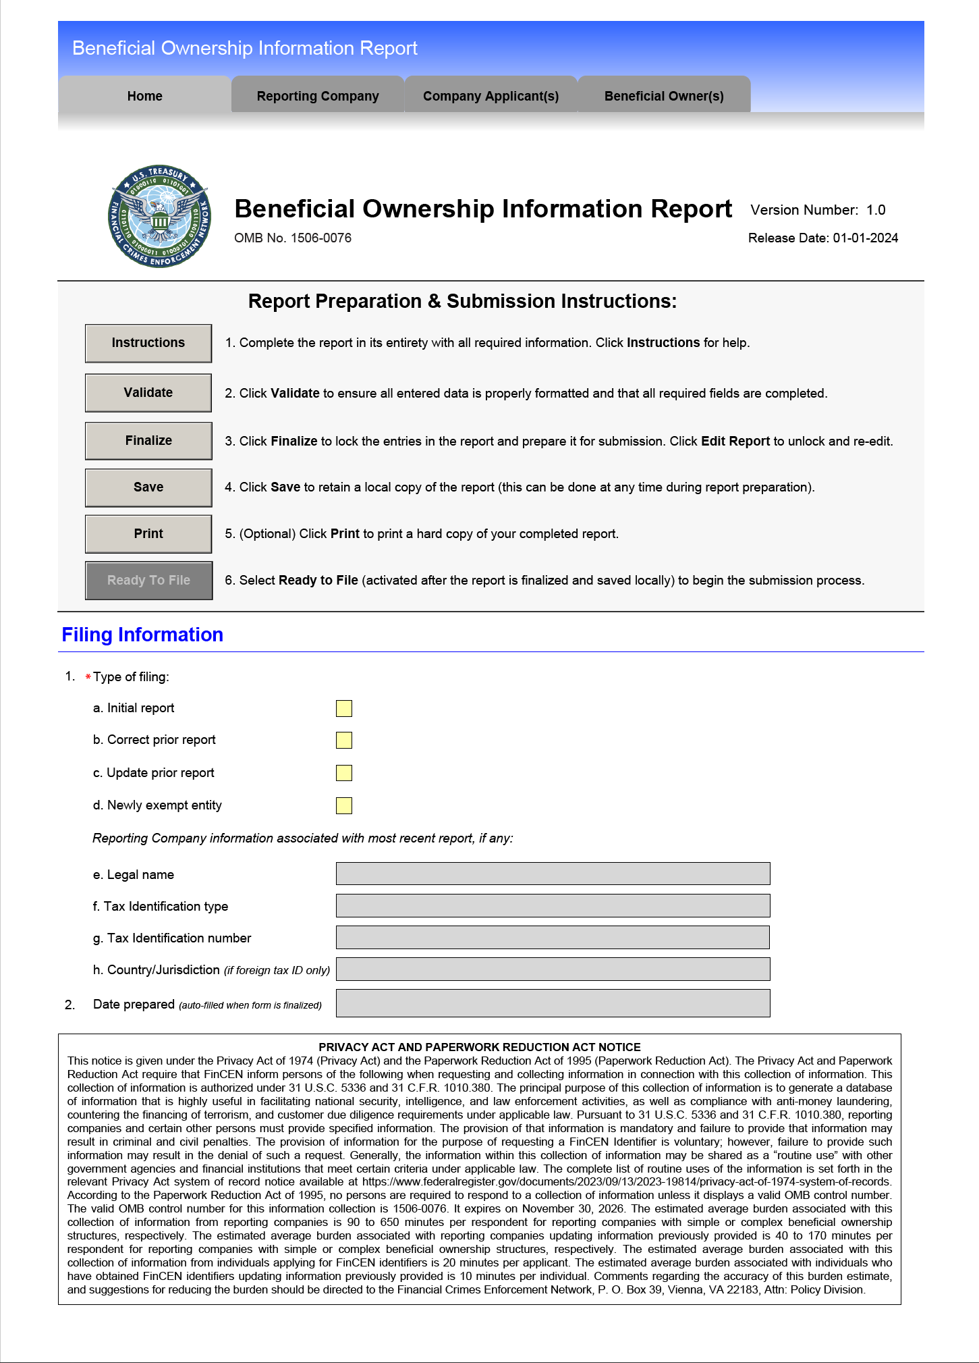
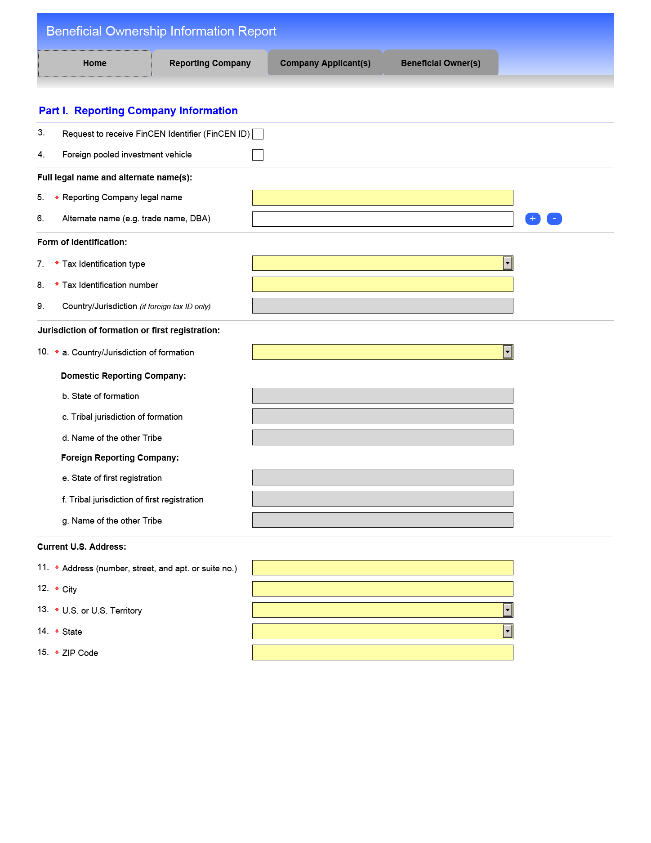
How do you file BOI?

Slide 17
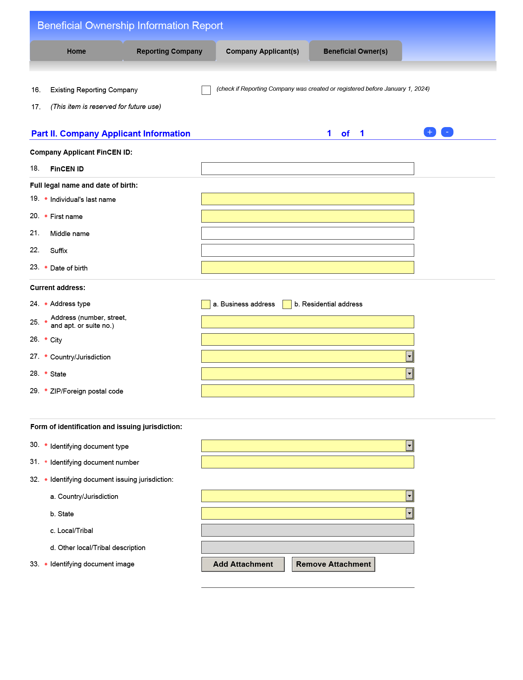
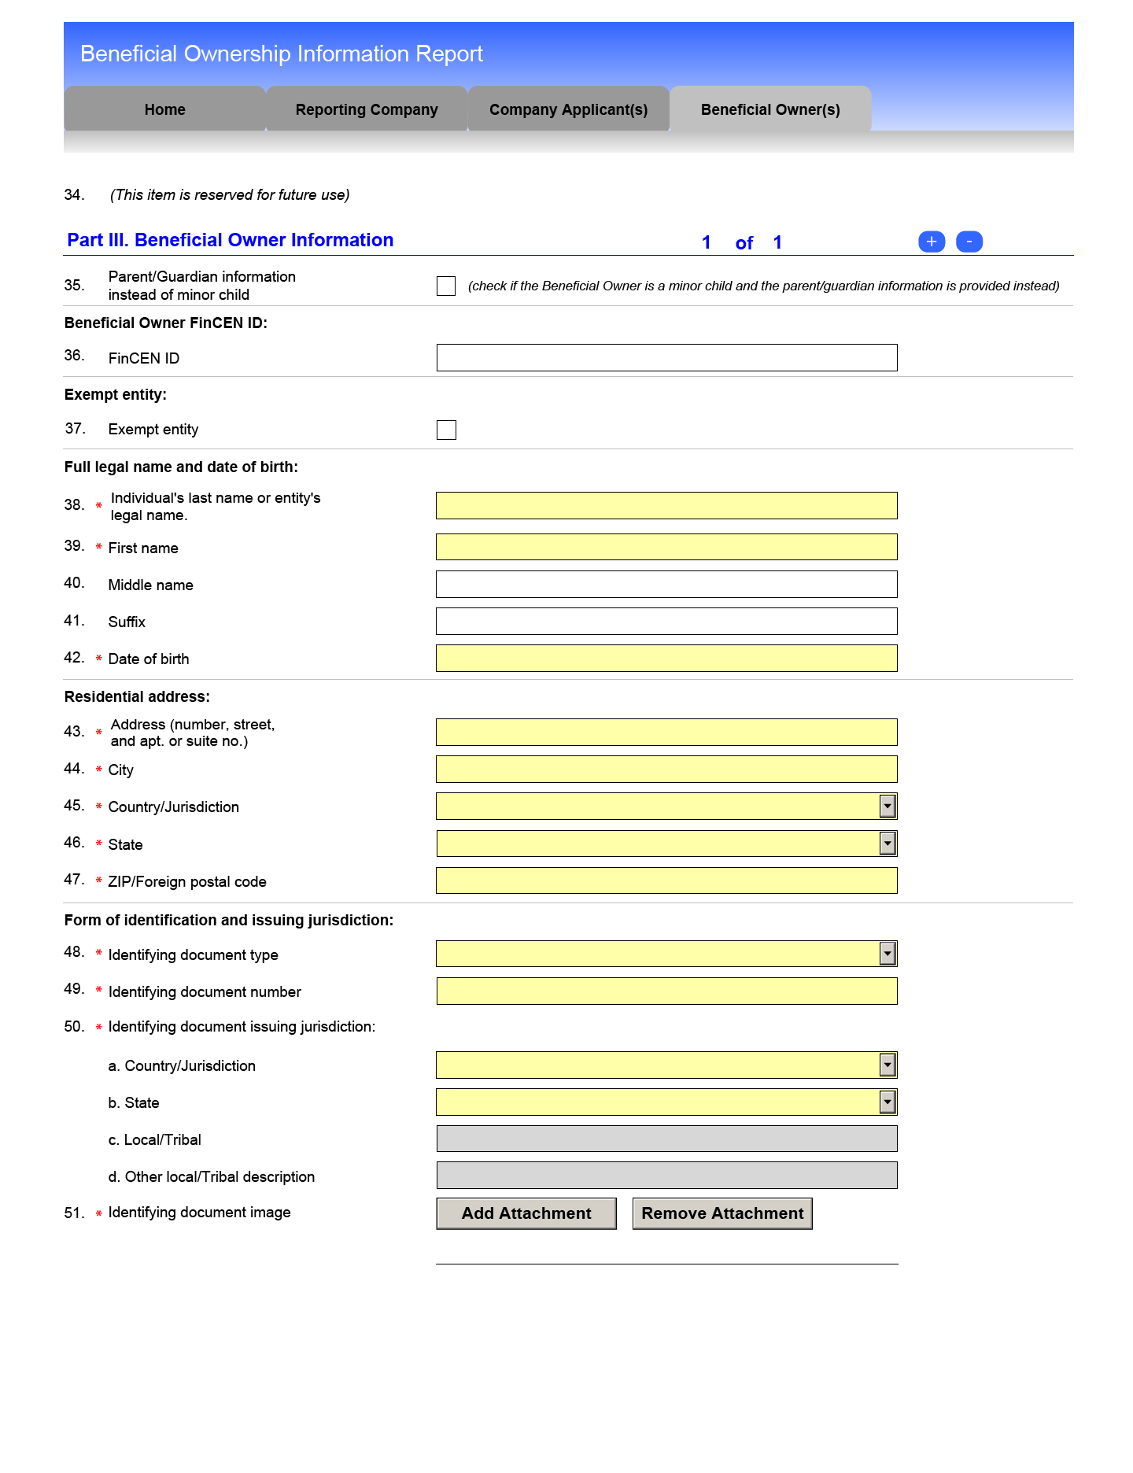
How do you file BOI?

Slide 18
Example 1
Salon with a 100% owner and $800k of revenue that has about 15 employees.
Required to file. 100% owner is likely the only person that is reported.

Slide 19
Example 2
Restaurant with three equal 33.3% owners and one manager who has access to the books and runs day to day operations. Restaurant has $3M of revenue and 50 employees.
Probably required to file, but would need to check the FTE count very carefully. They could easily be under 20 FTE with all the part time people.
All three owners would be required, and potentially the manager as well would be reported as beneficial owners.

Slide 20
Example 3
Manufacturing business with three equal 33.3% owners and one CFO who has access to the books and runs day to day operations. Business has $3M of revenue and 50 employees. Additionally the same owners own the building in a different entity.
All three owners would be required, and the CFO would be reported as beneficial owners.
All three owners would be reported a second time for the rental property entity.

Slide 21
Example 4
Construction business with three equal 33.3% owners and one CEO who has access to the books and runs day to day operations. Entity has $6M of revenue from one office location and one storage facility and 80 employees. Additionally the same owners own the two buildings (office and storage) in two different entities.
If more than 20 FTE then the Construction business is exempt. All three owners would still need to be reported for the rental property entities, so they each get reported twice. Rental still required to file even if Construction business is exempt under large business exception.

Slide 22
Example 5
Construction business with three equal 33.3% owners and one CEO who has access to the books and runs day to day operations. Entity has $16M of revenue from one office location and one storage facility and 10 employees (with lots of subcontractors). Additionally the same owners own the two buildings (office and storage) in two different entities.
The three owners plus the CEO get reported for the Construction business. Then the three owners get reported a second and third time for the two rental properties.

Slide 23
Closing Thoughts
Large entities are exempt, but nearly every large entity I work with also has small entities that are not exempt.
For rental properties it’ll be easy to identify who the beneficial owner is, other tiered structures it can be quite complex to determine who the beneficial owners are
Initial report is due by 12-31-2024
Penalties are severe, so have a plan for filing in 2024
Have a plan for tracking changes in 2025

Slide 24
We Are Here To Help
BOI Services
We are working with clients to get BOI filed. It’s $500 for the first report and $250 for each report thereafter. For clients with a high volume of reports we can work out special pricing. Reach out to Kevin kberg@myboyum.com
We have helped clients file 100+ of these reports since officially starting in July. Included is reminders for the 2025 year to report changes to the situation.
Self filing for no charge can be done yourself online through https://www.fincen.gov/boi the FinCEN Small Business Compliance Guide will help and can be found here https://www.fincen.gov/sites/default/files/shared/BOI_Small_Compliance_Guide.v1.1-FINAL.pdf
24

